Slide 1
Computational Model & Experimental Scenarios

Slide 2
Summary
Aim: Solve PDEs faster with unknown governing equations
Solution: Model PDEs in spectral space using LSSVR
Motivations
Many complex systems can become cumbersome to solve traditionally or even only solvable with statistical modeling
Fast surrogate for forward modelling
Model with strong mathematical guarantees of global minima
More interpretable model decisions

Slide 3
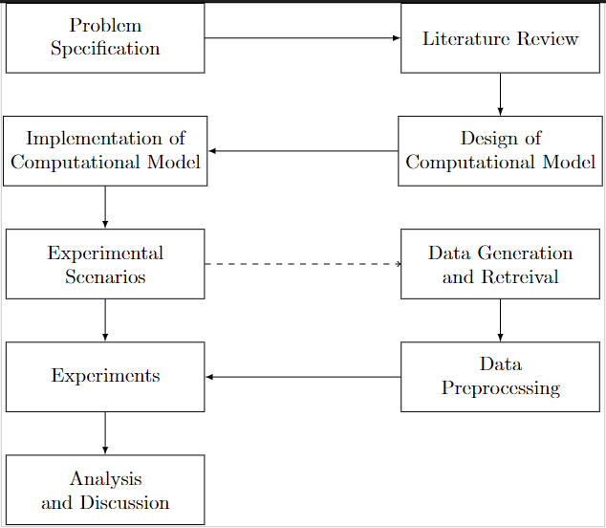
Research Design

Slide 4
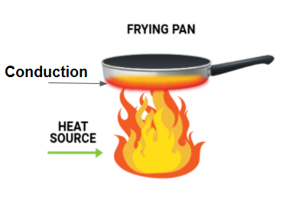
Experimental Scenarios
(Proof of Concept) Learning simple antiderivatives:
Input: Derivative function
Output: Antiderivative function (integral)
Learning heat equation:
Input: Heat source distribution
Output: Temperature distribution
Learning weather initial value problem:
Input: Weather state distribution at time t (temperature, wind speed, pressure)
Output: Weather state distribution at time t+1
Inverse problem of heat source control:
Input: Target temperature distribution
Output: Heat source distribution

Slide 5
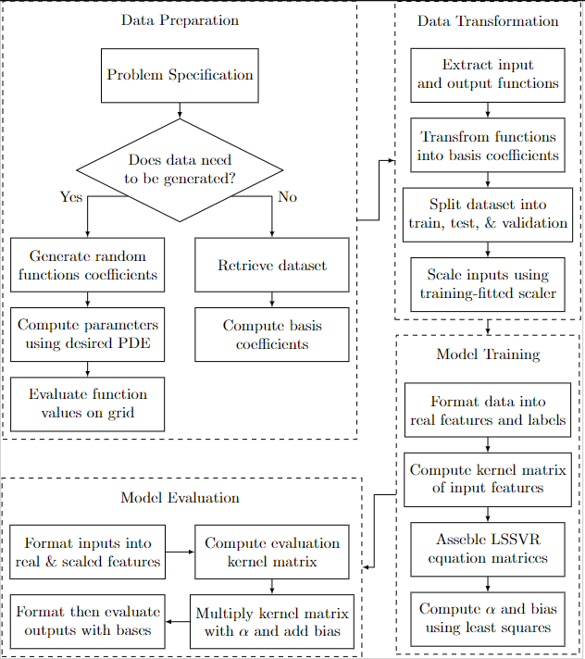
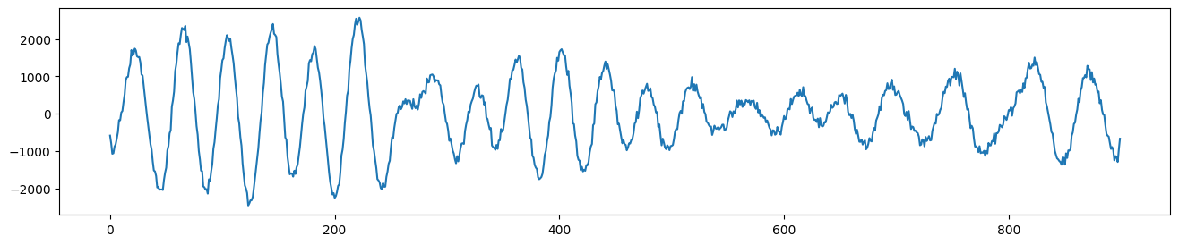

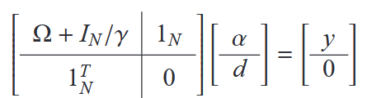
Computational Model
[a+ib,a2+ib2]=>[a,b,a2,b2]

Slide 6
Inverse Problem Computational Model
Initial Parameters
Input functions (Parameters)
Solve PDE
Gradient Descent
Compute Solution Gradient

Slide 7
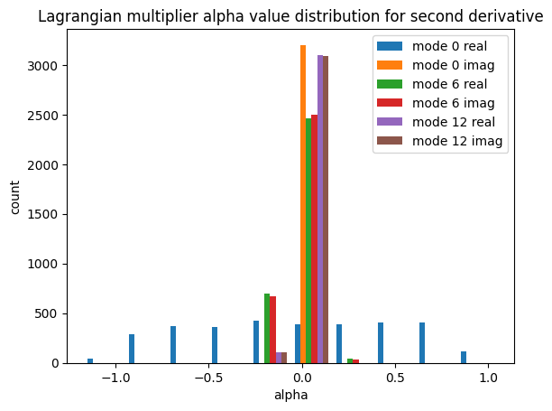
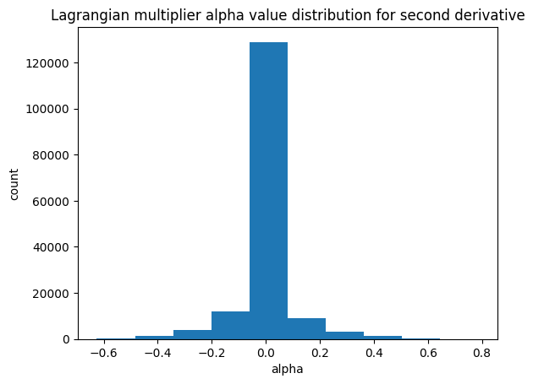
Antiderivative (second derivative)

Slide 8
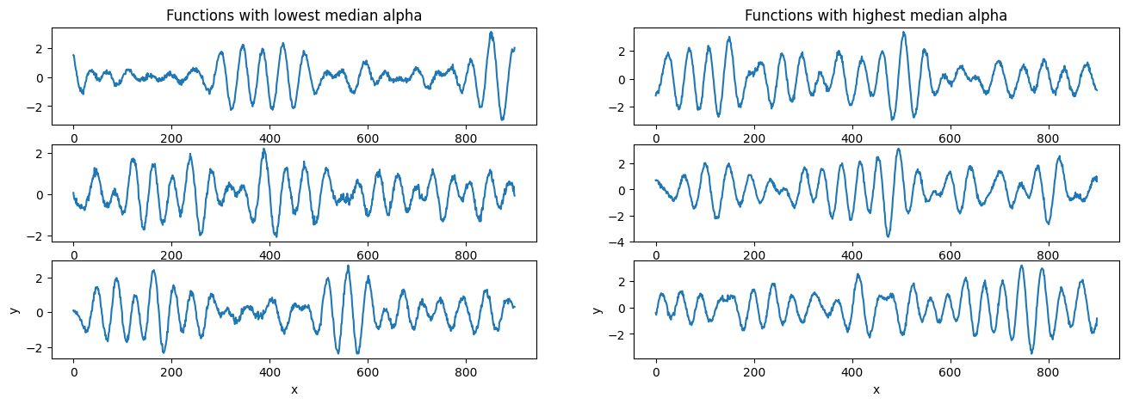

Slide 9
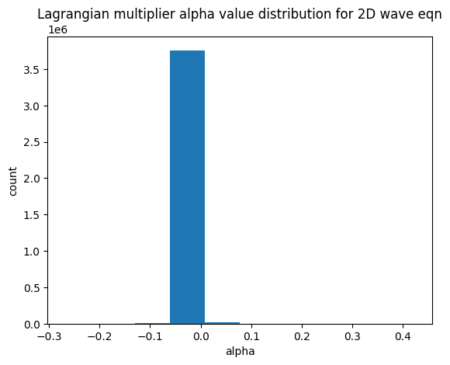
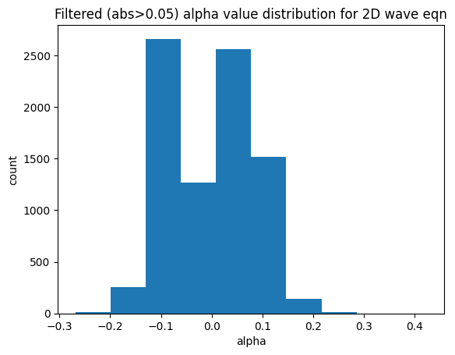
Wave Equation

